Slide 1


POV Leveraging Iceberg Tables in Snowflake Data Cloud

Slide 2
Agenda
Objective of the Project
Scope of the Work for the Project
Solution Approach and Architecture Designed
Team Member Who worked and on what Areas
Future Enhancements or Feature Plan post Hackathon
Live Demo
Q&A

Slide 3
Objective
Objective of the Project
To demonstrate the transformative potential of Snowflake's Iceberg Table’s feature in the context of a data lake strategy to enhance data management and improve query performance while maintaining data quality and integrity in a scalable and cost-effective manner.
​

Slide 4
Scope
Scope
Design and implement a proof of concept that leverages Iceberg Tables in Snowflake Data Cloud.​
Implement Snowflake Unmanaged Iceberg Tables​
Implement Snowflake Managed Iceberg Tables​

Slide 5
Solution Approach
Implement Snowflake Unmanaged Iceberg tables and showcase the following capabilities​
Setup Apache Iceberg tables and Catalog using AWS S3 and manage the same in AWS Glue.​
Access the Iceberg tables as Unmanaged Iceberg tables in Snowflake.​
Integrate snowflake unmanaged Iceberg table with Snowflake native tables .​
Apply and showcase Snowflake Dynamic Data masking, Data sharing features.​
Implement Managed Iceberg tables and showcase the following capabilities​
Setup Snowflake Managed Iceberg Tables.​
Ingest and modify data by Snowflake.
Access the Snowflake Managed Iceberg tables through Spark​
Integrate snowflake managed Iceberg table with Snowflake native tables .​
Showcase Time travel, Dynamic data masking and Data sharing features in managed Iceberg tables.​

Slide 6
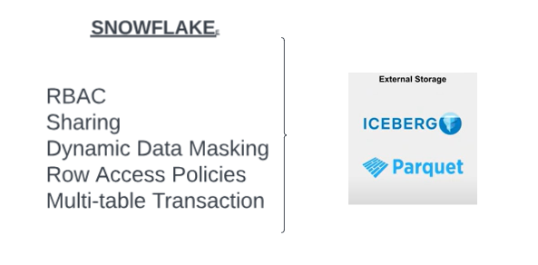
Features & Functionality
Data lake Integration​
Performance parity​
Interoperability​
Schema Evolution​
Incremental Processing​
Cost Efficiency​
Data Governance and Scalability

Slide 7
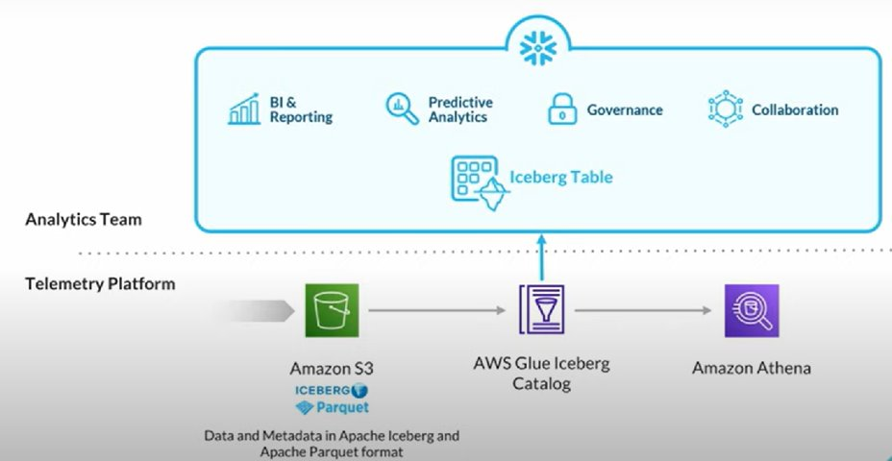
SNOWFLAKE UNMANAGED ICEBERG ARCHITECTURE

Slide 8
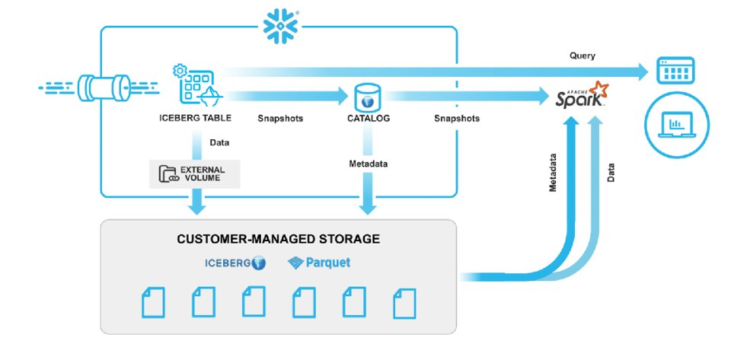
SNOWFLAKE MANAGED ICEBERG ARCHITECTURE

Slide 9
Team Member worked in which areas
Team Owners (Part-Time) : Dhamu / Syamsundar Gudibandi
Support Team (Part-Time)
Syamsundar Gudibandi
Mounika Koduru
Srisai Maddukuri
Uha Priya Akunuri
MANAGED ICEBERG TABLES UNMANAGED ICEBERG TABLES
Swetha Appisetty Himabindhu Ogirala​​
Gayathri Arepalli Anil Bitra​​​​
Akshitha Veesam Surendra Reddy Sanayapalli​​

Slide 10
Future Enhancements or Feature Plan post Hackathon
Migration of Data lake unmanaged Iceberg Tables to Snowflake Managed Iceberg Tables​.

Slide 11
DEMO

Slide 12
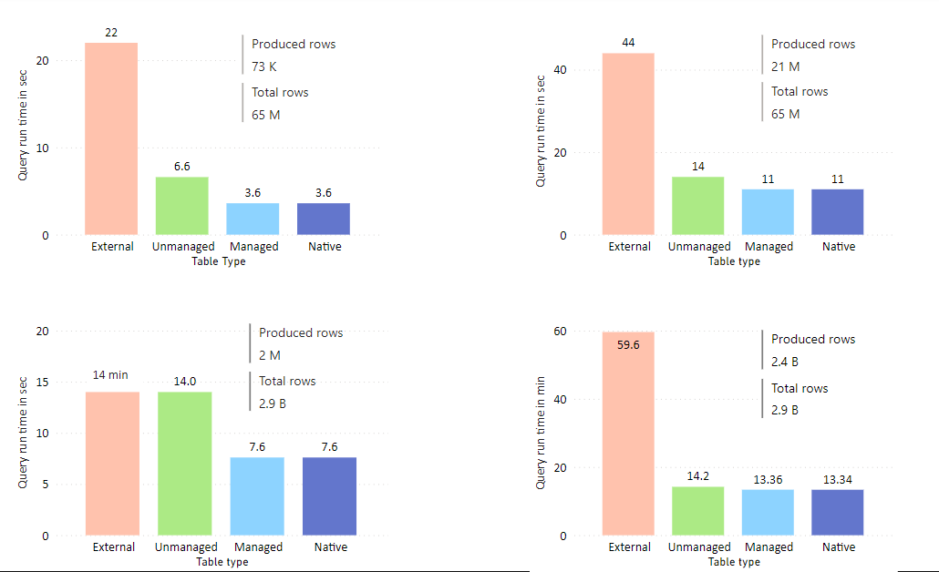
Performance Parity

Slide 13
Q&A

Slide 14





Thank You

